Slide 1
Study of heavy-flavour baryons with machine learning with ALICE
Student: Giovanni Celotto Supervisor: Dr. Andrea Rossi
Date: 02/11/2022 Co-supervisor: Dr. Mattia Faggin

Slide 2
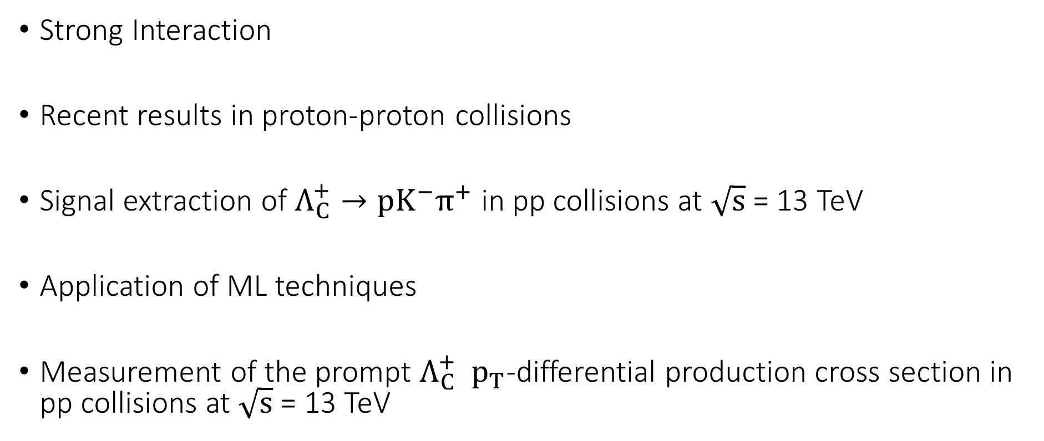
Outline
Strong Interaction
Recent results in proton-proton collisions
Signal extraction of $Λ_{C}^{+}→pK^{−}π^{+}$ in pp collisions at $\sqrt{s}$ = 13 TeV
Application of ML techniques
Measurement of the prompt $Λ_{C}^{+}$ $p_{T}$-differential production cross section in pp collisions at $\sqrt{s}$ = 13 TeV

Slide 3
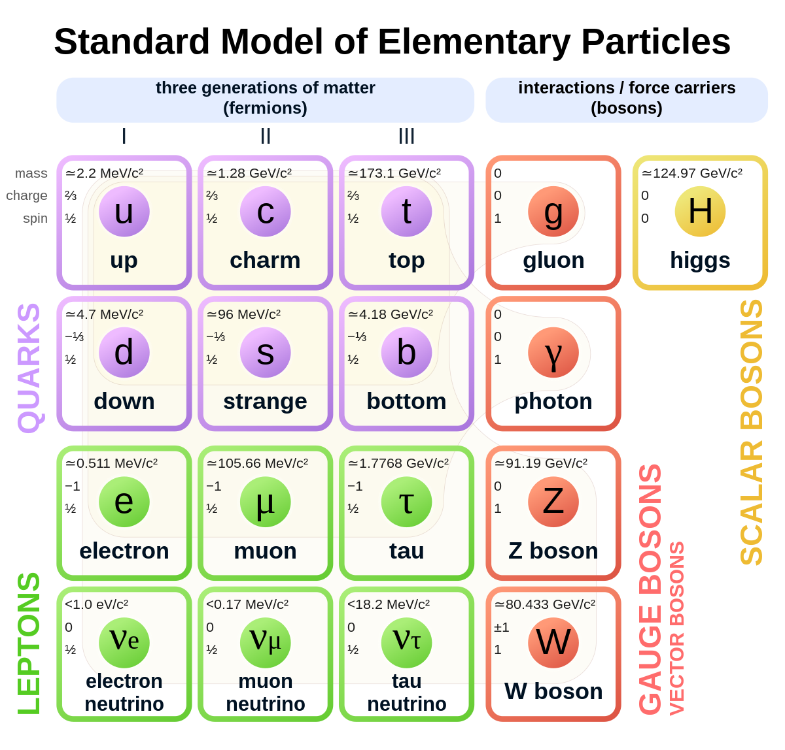
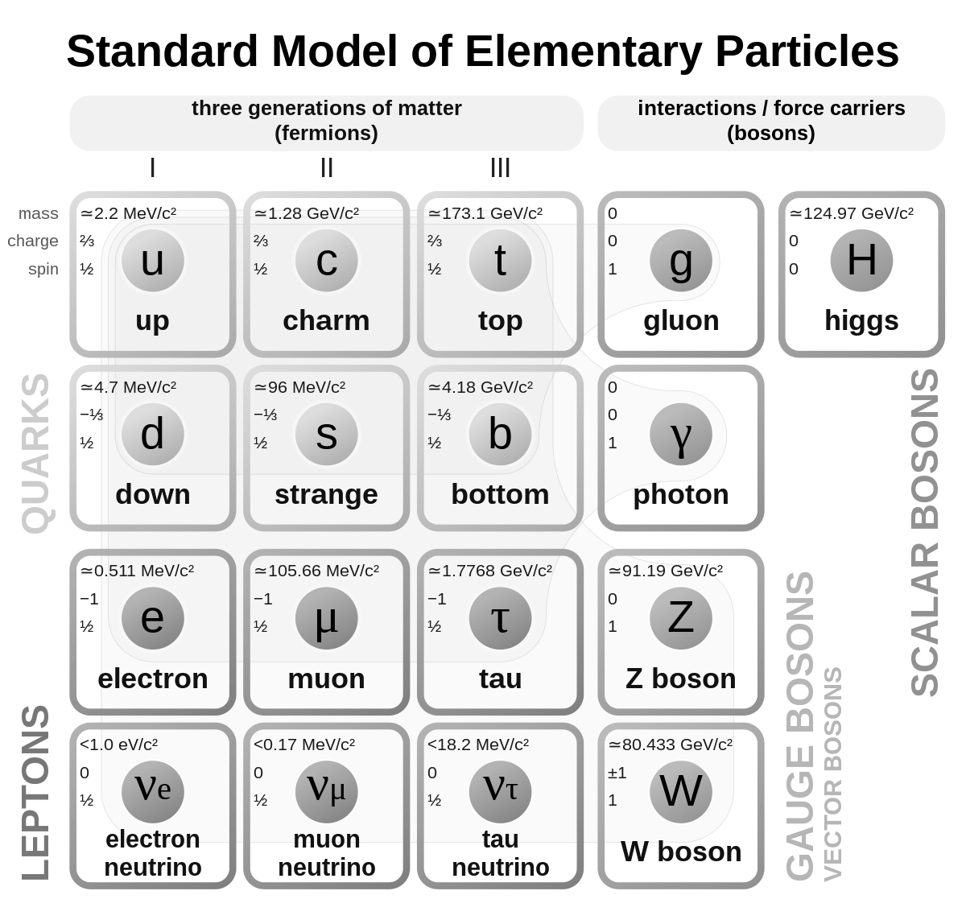
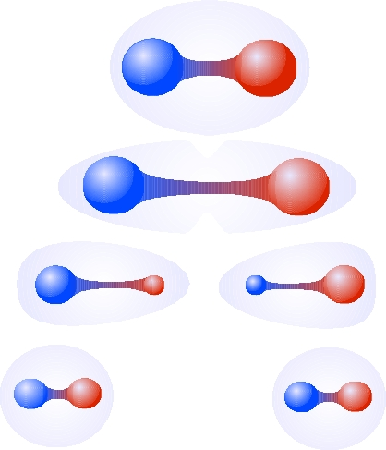
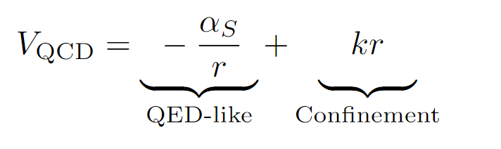
Strong interaction and Hadron physics
Nuclear matter is made of neutrons and protons
Hadrons are bound states of two or more quarks
The force carriers of the strong interactions are the gluons
Quarks and gluons have never been observed as free particles

Slide 4
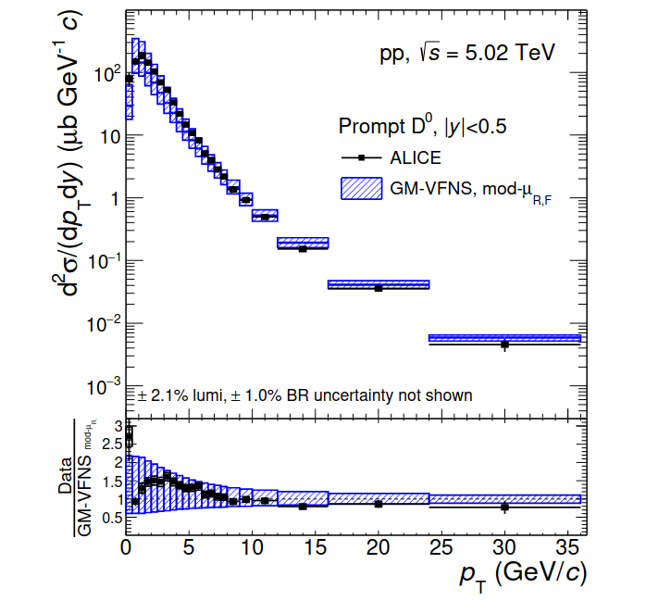
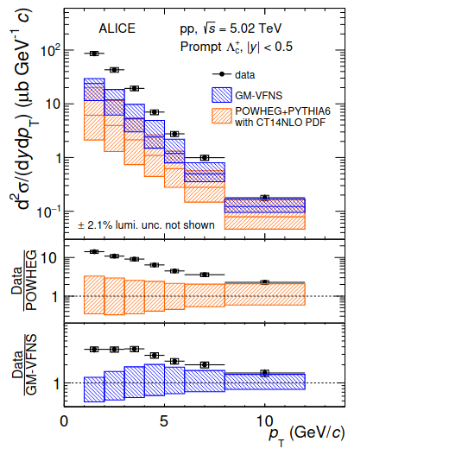
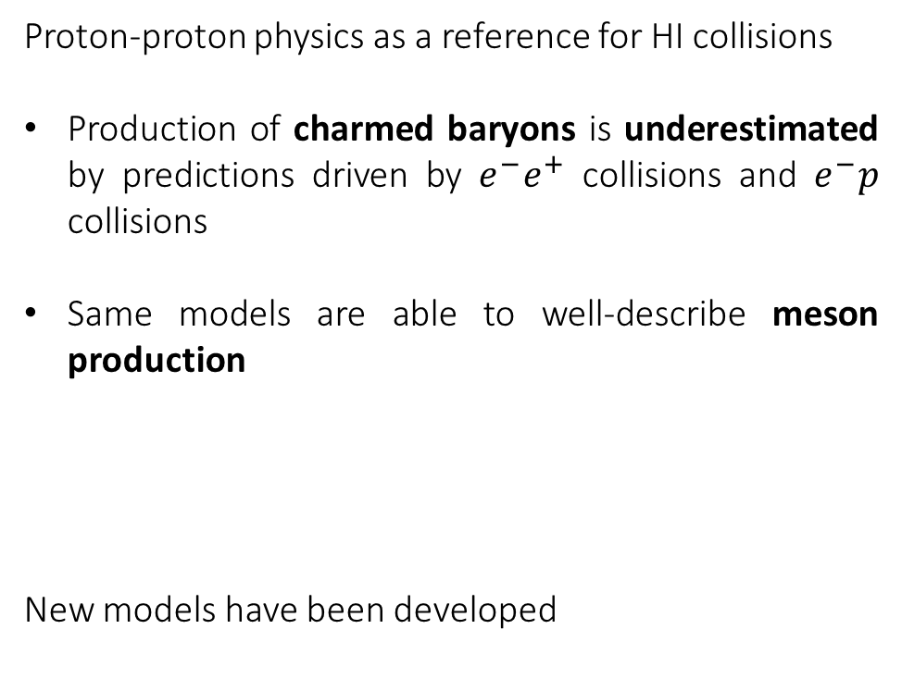
Recent results in pp collisions
Proton-proton physics as a reference for HI collisions
Production of charmed baryons is underestimated by predictions driven by $e^{−}e^{+}$ collisions and $e^{−}p$ collisions
Same models are able to well-describe meson production
New models have been developed

Slide 5
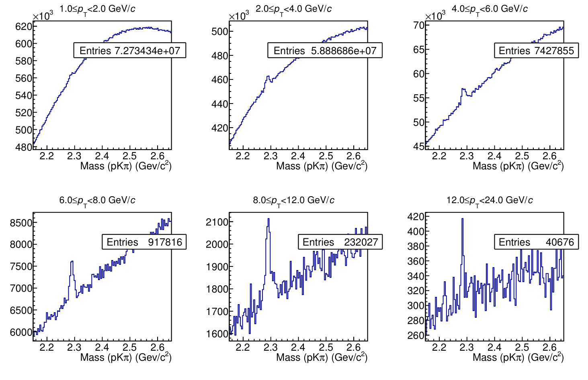
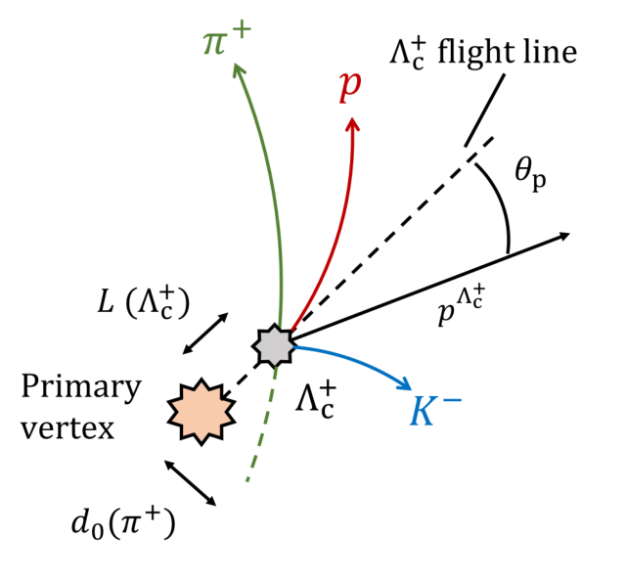
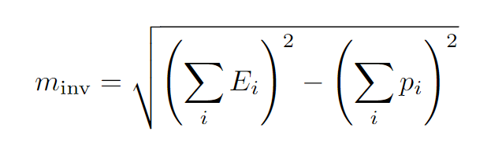
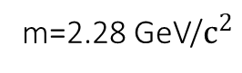
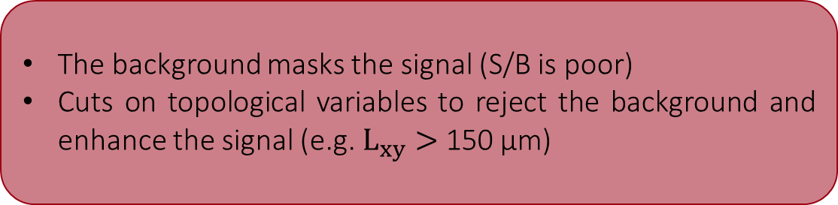
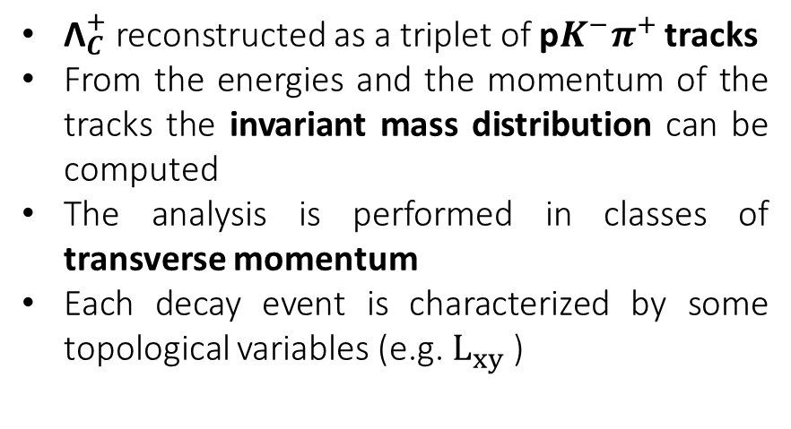

$Λ_{C}^{+}→{pK}^{−}π^{+}$: Signal extraction
u
d
c
m=2.28 GeV/$c^{2}$
${\text{Λ}}_{C}^{+}$ reconstructed as a triplet of p$K^{−}π^{+}$ tracks
From the energies and the momentum of the tracks the invariant mass distribution can be computed
The analysis is performed in classes of transverse momentum
Each decay event is characterized by some topological variables (e.g. $L_{xy}$ )
The background masks the signal (S/B is poor)
Cuts on topological variables to reject the background and enhance the signal (e.g. $L_{xy}>$ 150 μm)

Slide 6
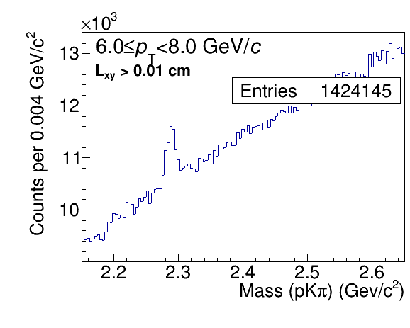
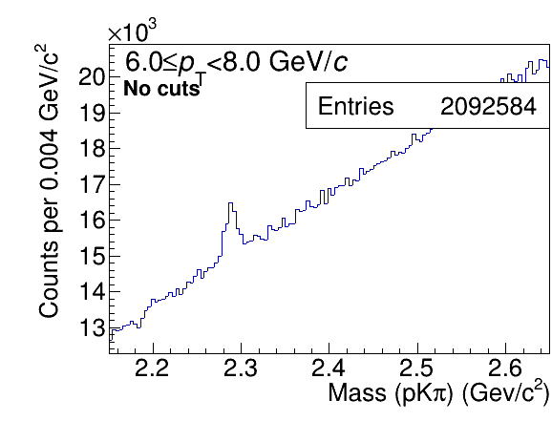
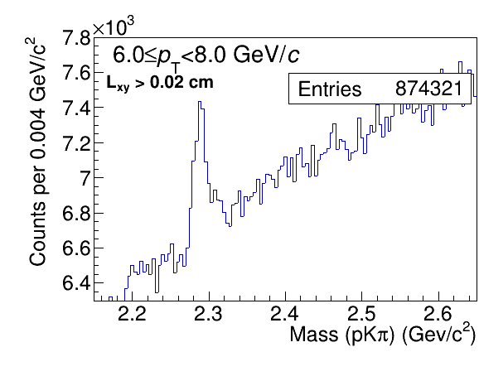
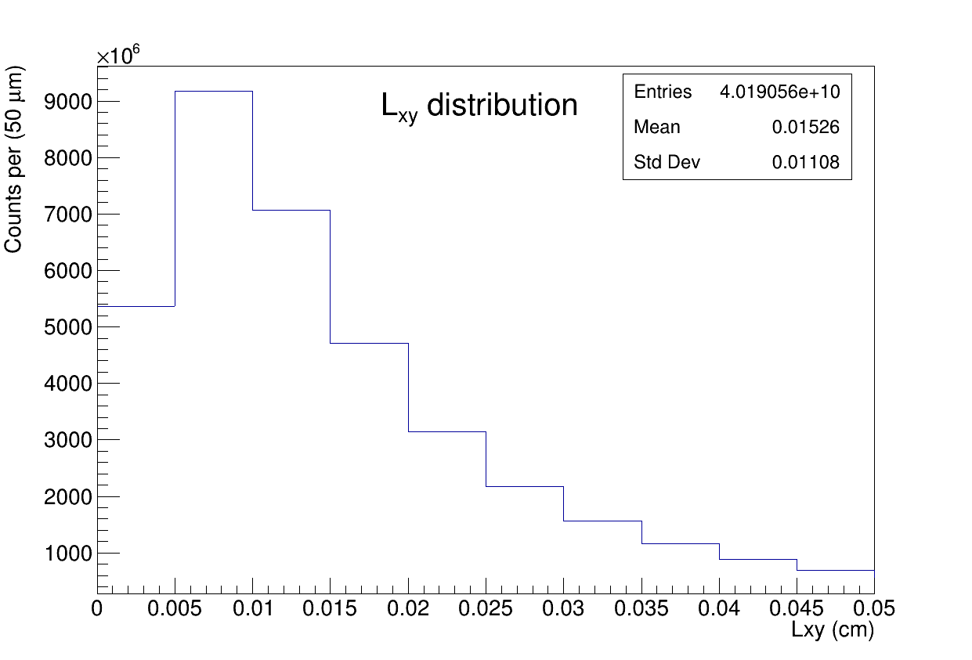
Cuts on topological variables
4 topological variables
Cosine of Poynting angle
Decay Length on the xy plane
Normalized Decay Length on the xy plane
Maximum topomatic distance

Slide 7
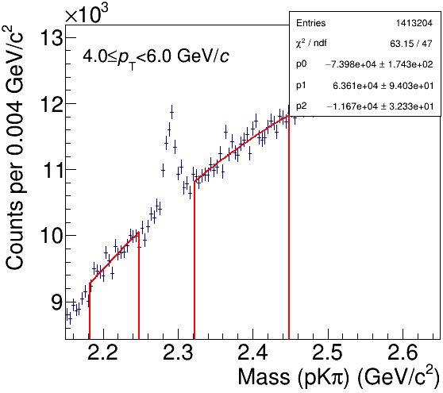
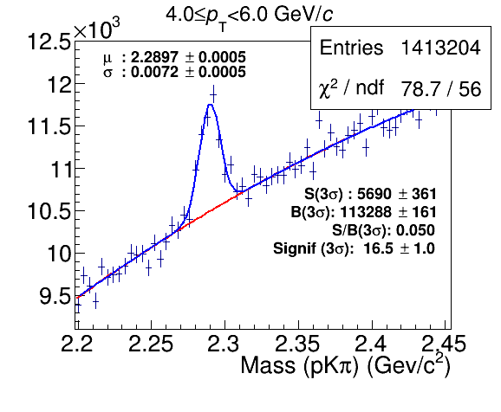
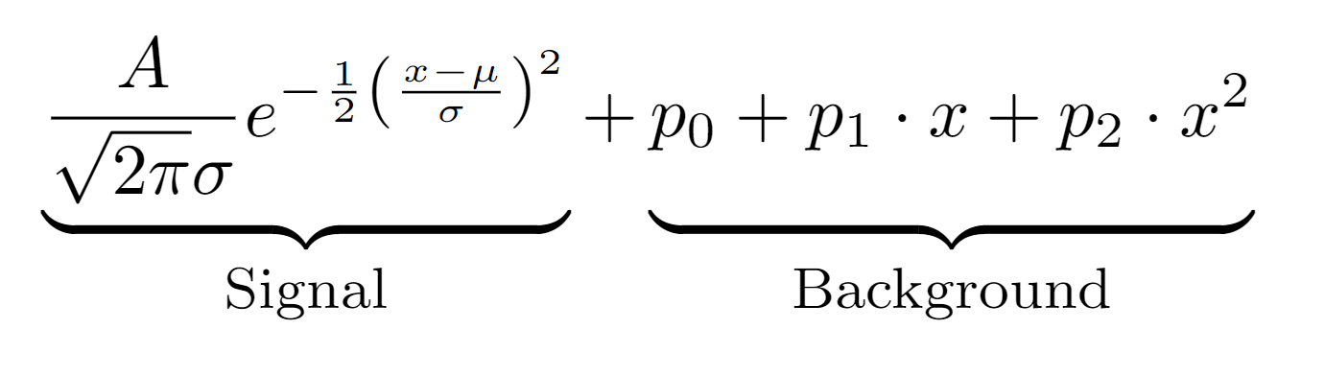
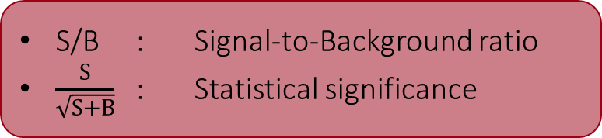
Fit procedure
Second-degree polynomial function to fit the background on the sides of the peak
Full fit of signal and background involves a Gaussian and a pol2
Second-degree polynomial function to fit the background on the sides of the peak
Full fit of signal and background involves a Gaussian and a pol2
S/B : Signal-to-Background ratio
$\frac{S}{\sqrt{S+B}}$ : Statistical significance

Slide 8
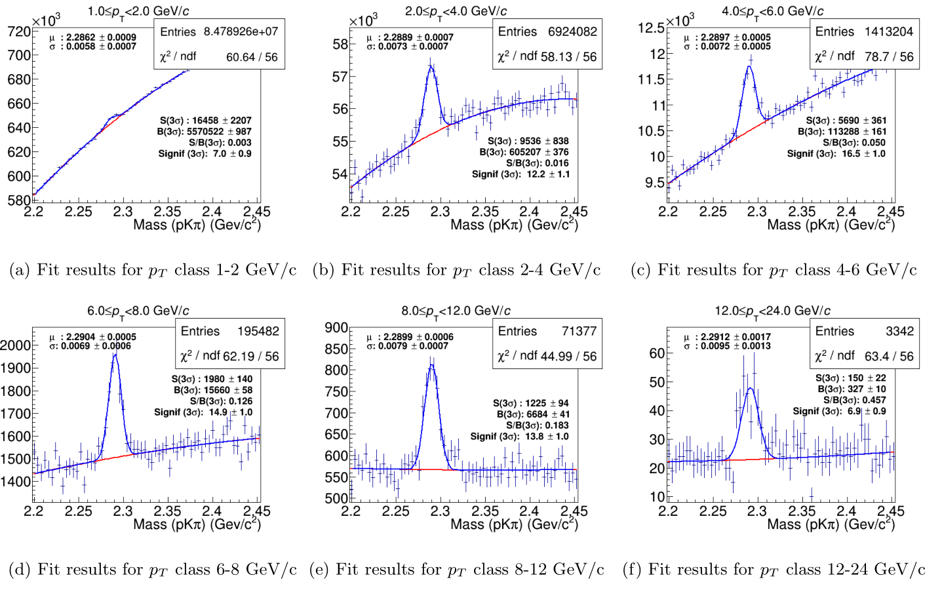
Optimization of S/B
One variable by one is scanned in 10 possible thresholds
Aim: maximizing S/B without reducing the significance
After finding an optimal cut, the next variable is scanned
Improvement of S/B
Good Statistical Significance
The analysis is not blind
The optimization is local

Slide 9
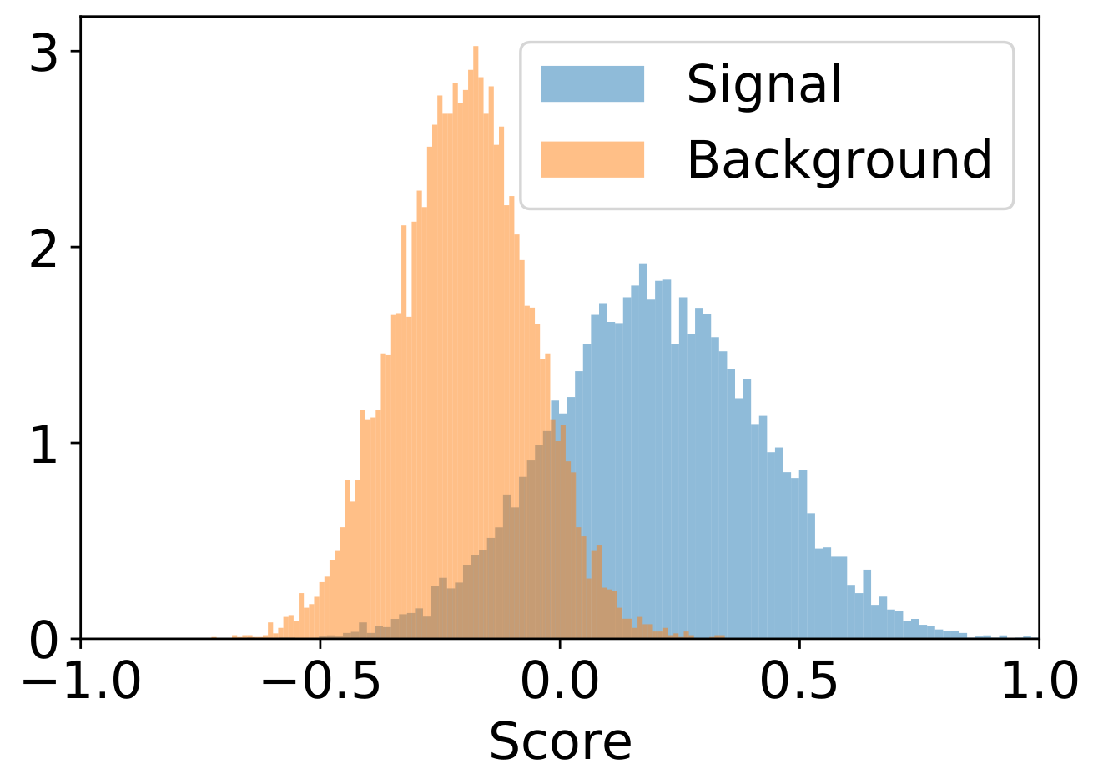
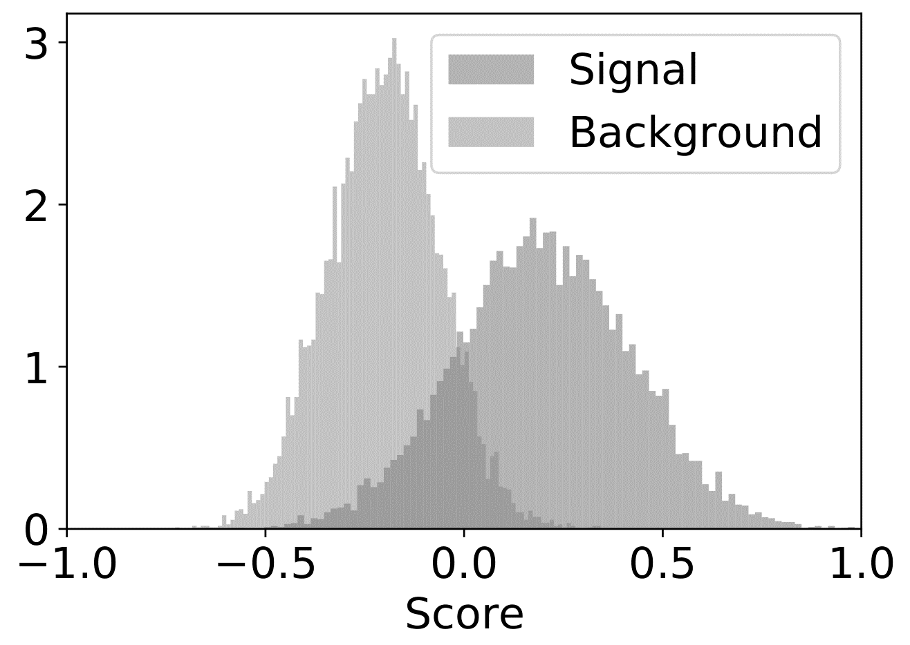
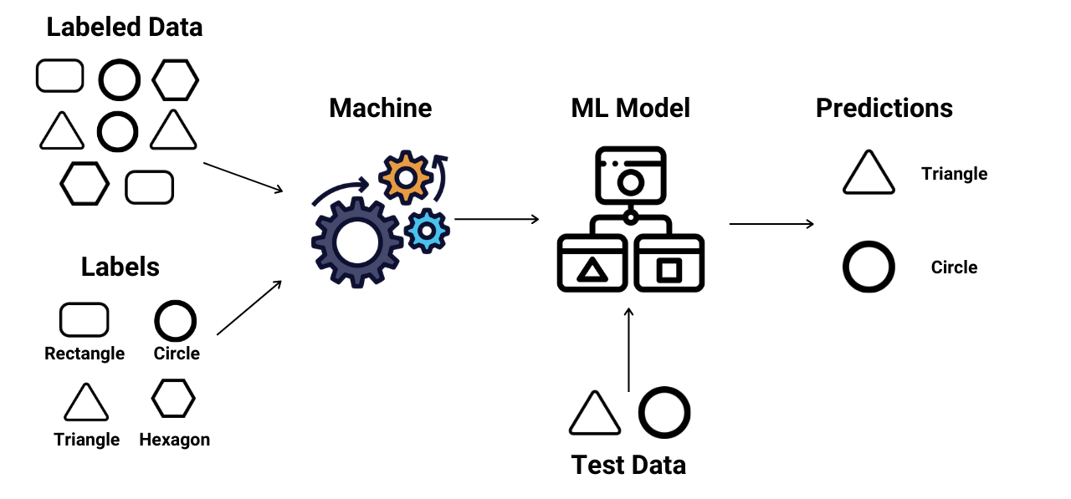
ML techniques on Signal-Background discrimination
Why do we need ML?
The analysis is not blind
The optimization is local
S
S
S
B
B
B
S
B
S
Signal
B
Background
?
?

Slide 10
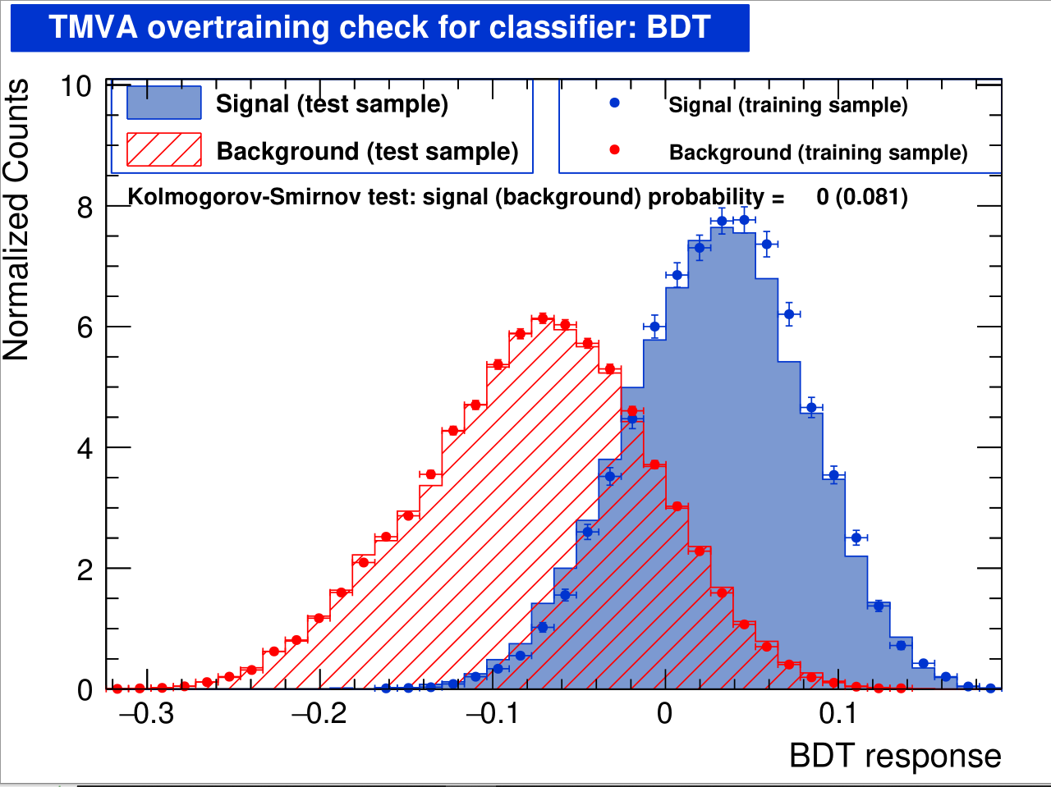
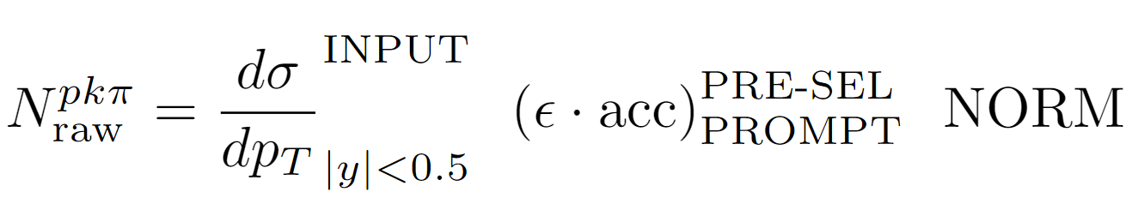
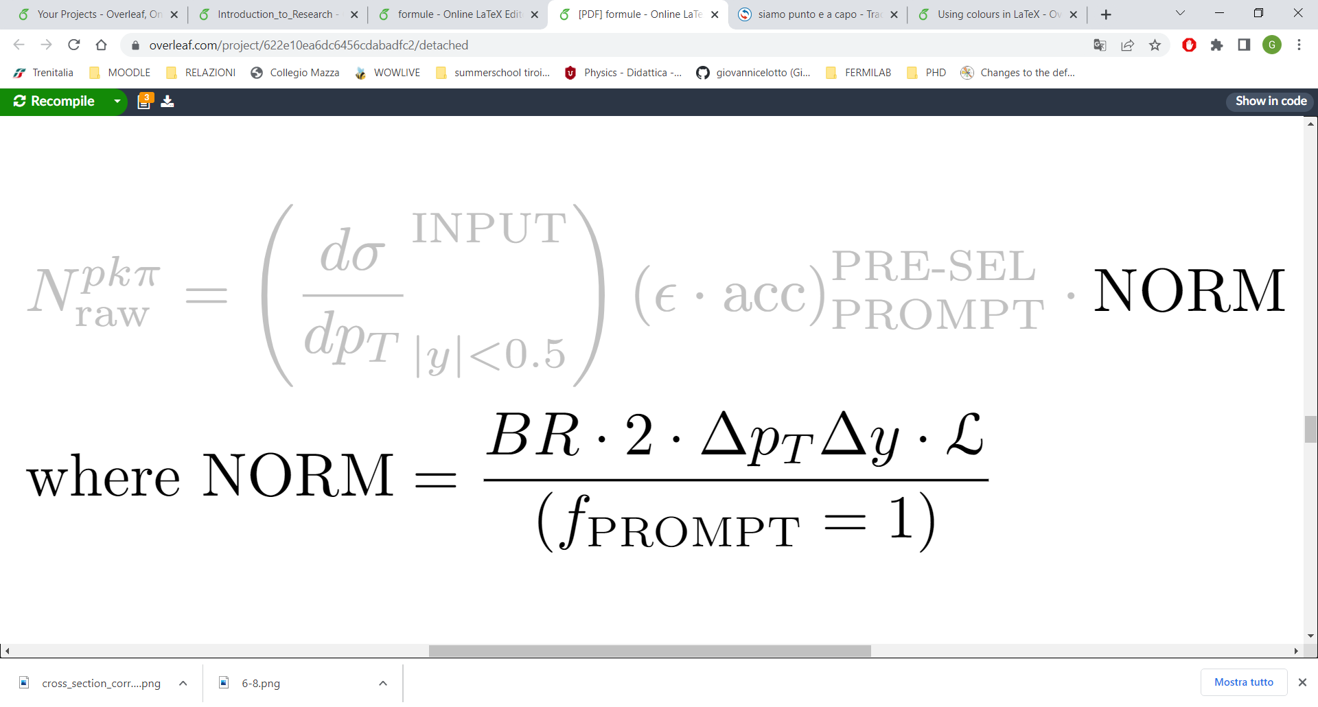
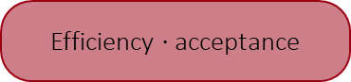
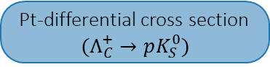
ML on the data: Application
Determination of the working point (i.e. Cut on the score that maximizes the significance)
Expected Background
Expected Signal
Pt-differential cross section
$$(Λ_{C}^{+}→pK_{S}^{0})$$
Efficiency $⋅$ acceptance

Slide 11
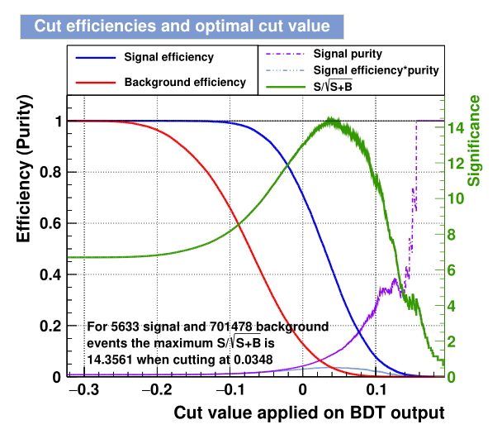
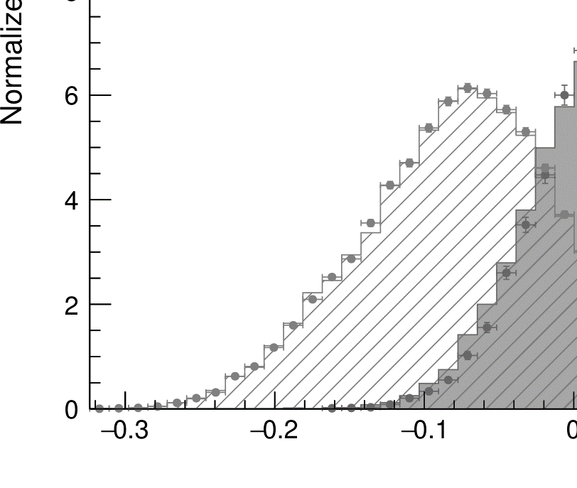
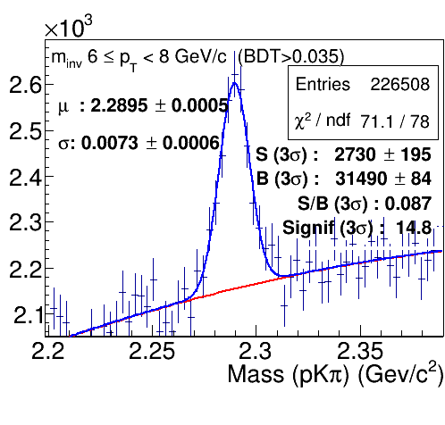
Determination of the working point
WP=0.035
Signif = 14.3

Slide 12
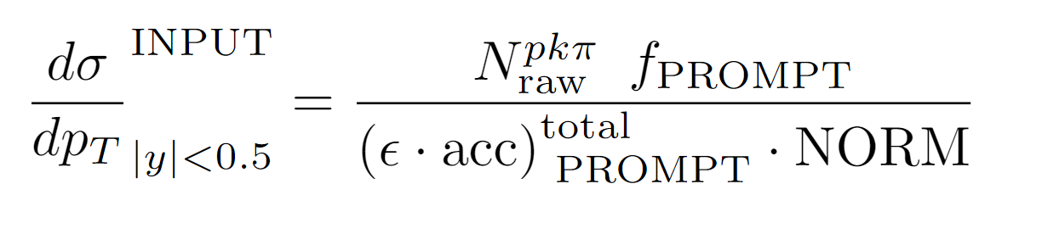
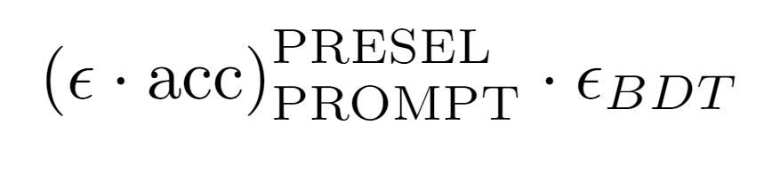

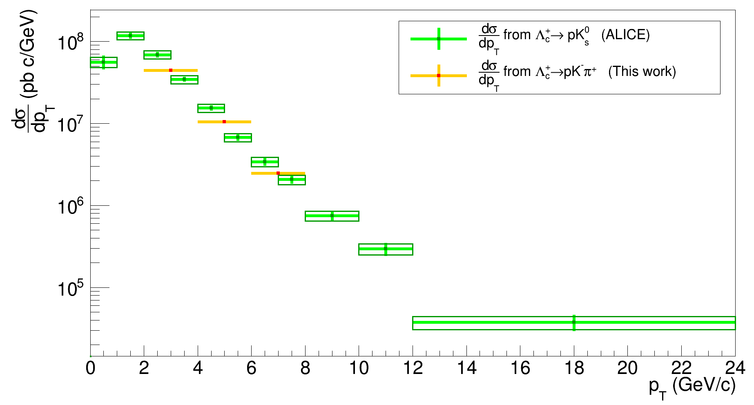
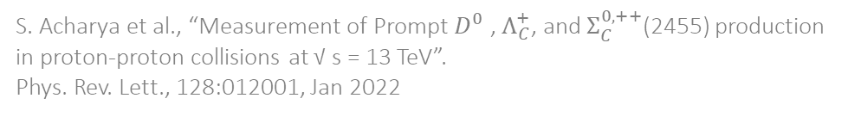
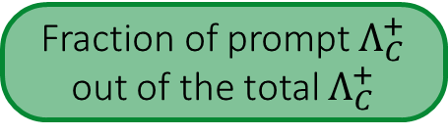
Measurement of the cross section
Signal from the fit
Fraction of prompt $Λ_{C}^{+}$ out of the total $Λ_{C}^{+}$
Our results are in good agreement with the values published by the ALICE Collaboration
S. Acharya et al., “Measurement of Prompt $D^{0}$ , $Λ_{C}^{+}$, and $Σ_{C}^{0,++}$(2455) production in proton-proton collisions at √ s = 13 TeV”.
Phys. Rev. Lett., 128:012001, Jan 2022

Slide 13
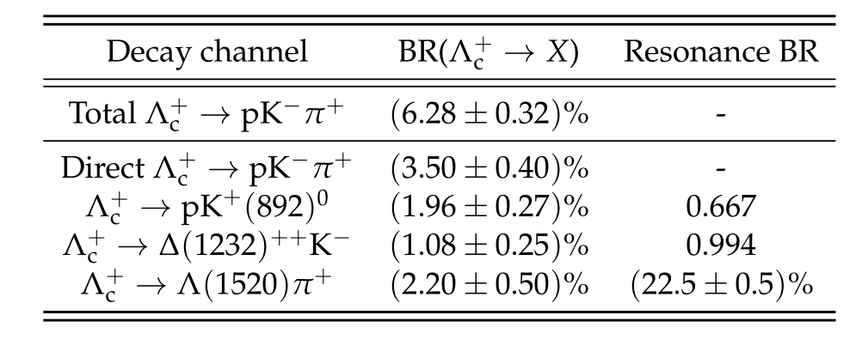
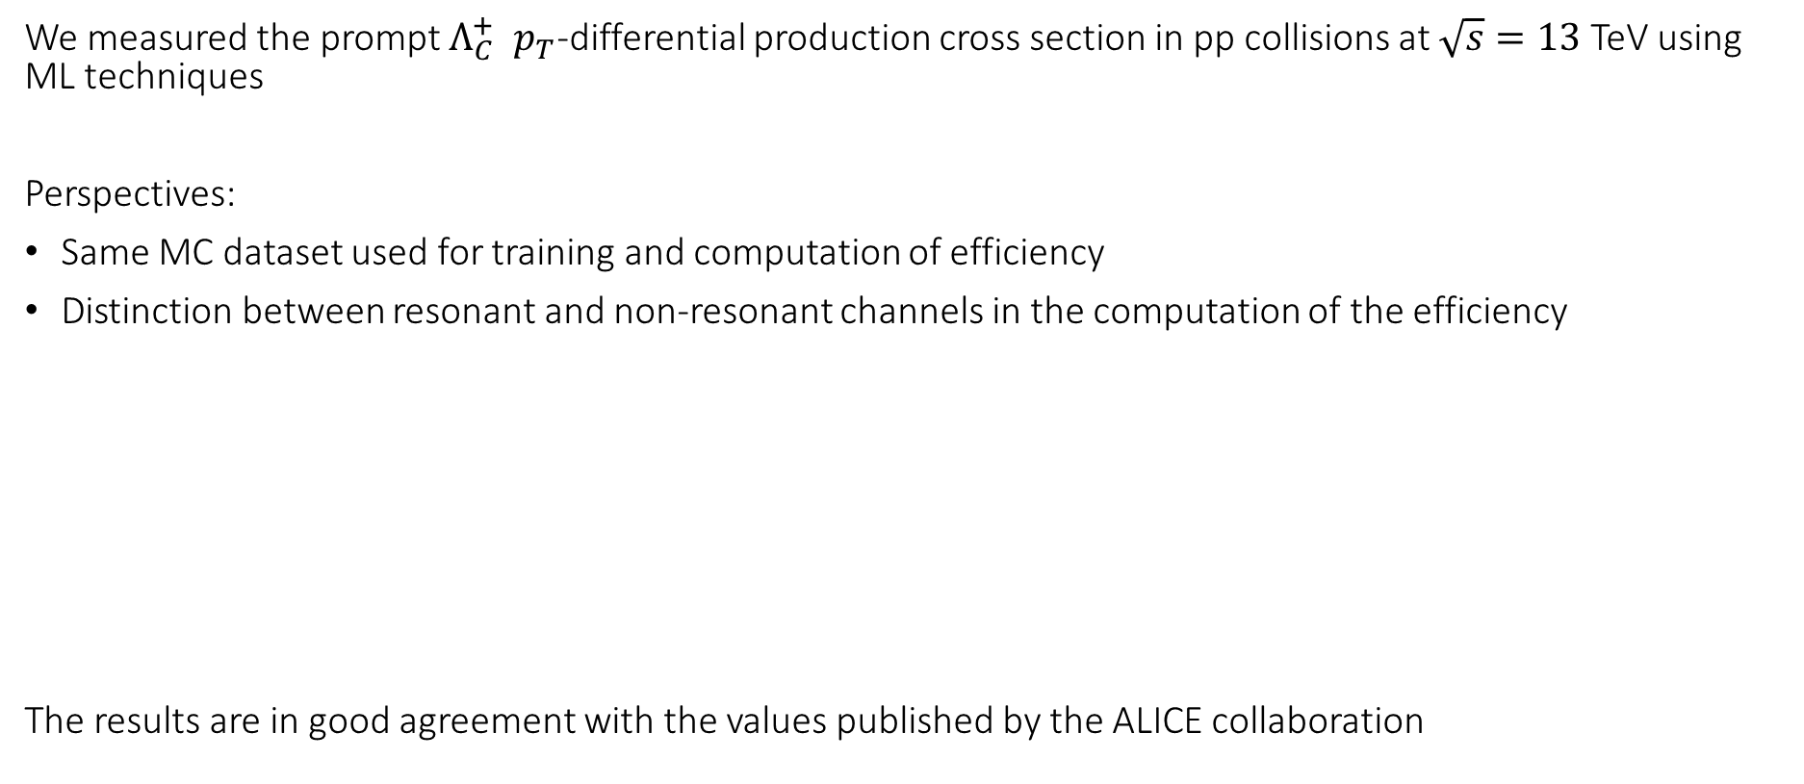
Conclusions and Perspectives
We measured the prompt $Λ_{C}^{+}$ $p_{T}$-differential production cross section in pp collisions at $\sqrt{s}=13$ TeV using ML techniques
Perspectives:
Same MC dataset used for training and computation of efficiency
Distinction between resonant and non-resonant channels in the computation of the efficiency
The results are in good agreement with the values published by the ALICE collaboration

Slide 14
Thank you for your attention

Slide 15
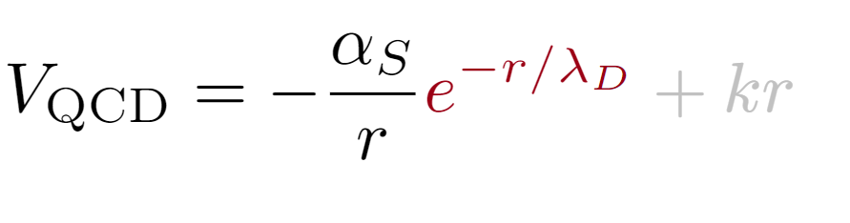
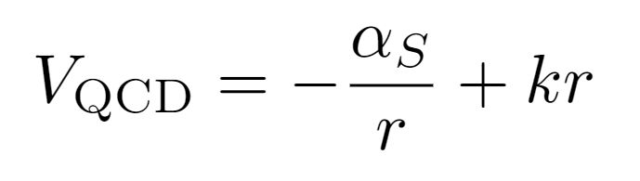
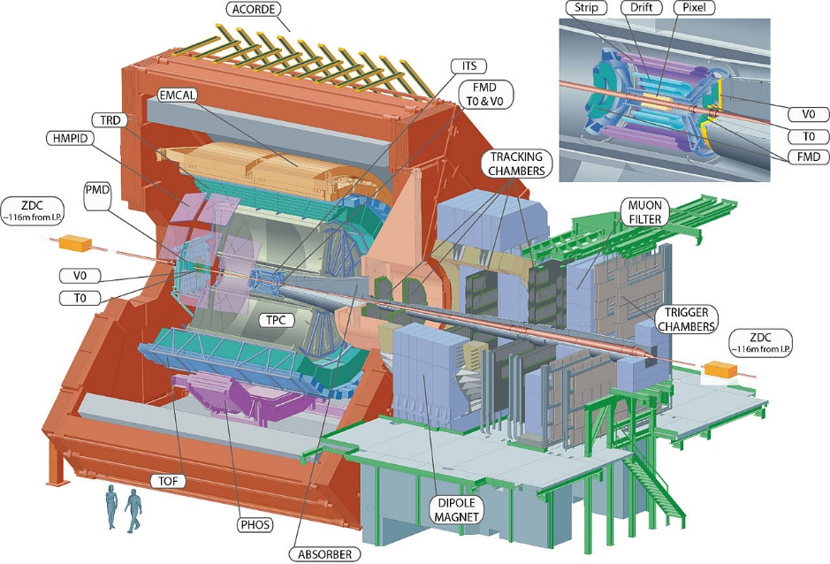
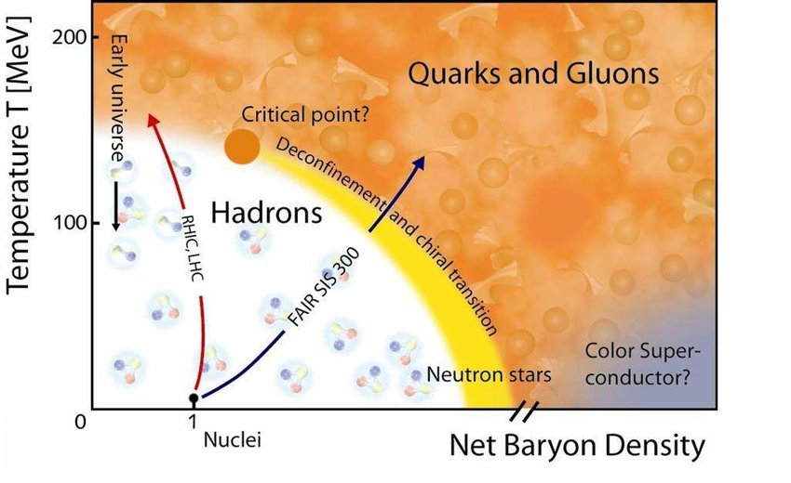
ALICE physics
Extreme conditions of energy density reached via HI collisions (Pb-Pb)
Modification of the QCD potential
Deconfinement of quarks and gluons (QGP)

Slide 16
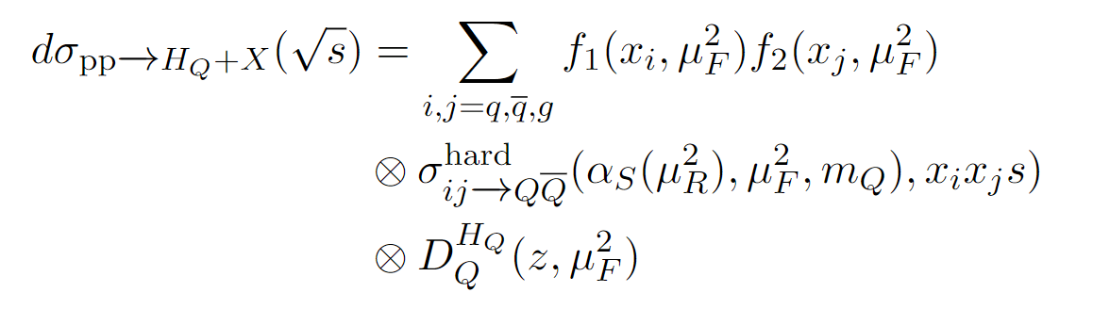
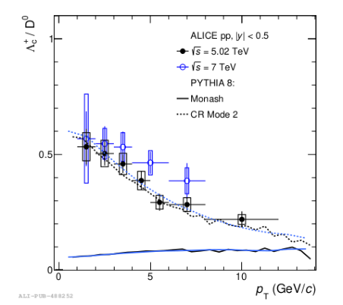
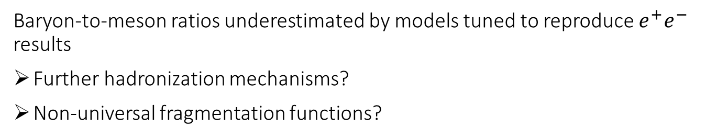

Hadron Production with ALICE in pp collisions
Production cross section for heavy-baryons can be factorized in three terms
Parton Distribution Function (PDFs)
Hard scattering cross section (pQCD)
Fragmentation function (hadronization)
PDFs from deep inelastic scattering
Fragmentation functions from $e^{−}e^{+}$ collisions
Baryon-to-meson ratios underestimated by models tuned to reproduce $e^{+}e^{−}$ results
Further hadronization mechanisms?
Non-universal fragmentation functions?
Notes:
Lund model implemented in Monash, the default tune of PYTHIA event generator

Slide 17
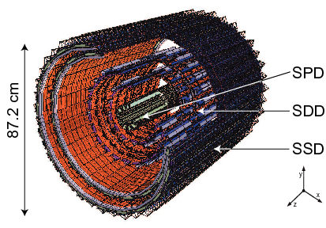
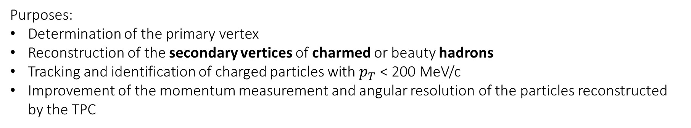
Experimental Setup: ITS
Six cylindricaal layers
SPD 3.9 cm 7.6 cm
SDD 15.0 cm 23.9 cm
SSD 38.0 cm 43.0 cm
Purposes:
Determination of the primary vertex
Reconstruction of the secondary vertices of charmed or beauty hadrons
Tracking and identification of charged particles with $p_{T}$ < 200 MeV/c
Improvement of the momentum measurement and angular resolution of the particles reconstructed by the TPC

Slide 18



TPC: General Features
Charged-particles tracking, momentum measurements and PID
Cylindrical Field Cage divided into 2 drift regions by the central HV electrode
Volume = 90$m^{3}$
84.8 cm < R < 246.6 cm
L=500 cm along the beam axis
Maximum drift path = 2.5 m
Endplates with readout chambers
18 sectors (${20}^{ ∘}$)
IROCs and OROCs

Slide 19

TPC: General Features
Charged-particles tracking, momentum measurements and PID
Cylindrical Field Cage divided into 2 drift regions by the central HV electrode
Volume = 90$m^{3}$
84.8 cm < R < 246.6 cm
L=500 cm along the beam axis
Maximum drift path = 2.5 m
Endplates with readout chambers
18 sectors (${20}^{ ∘}$)
IROCs and OROCs
Notes:
The gas choice has changed between run2 and 3 as well as the readout system on the endplates

Slide 20



TOF
Covers the central region ($\left|η\right|$<0.9)
Purposes: PID via TOF
Time resolution $≃$80 ps
A charged particle ionized the gas. An avalanche occurs due to a strong electric field
Resistive plates stop the avalanche formation in every gap
The plates are transparent to the fast signals induced on the electrodes by the fast motion of the electrons
The overall signal is the sum of the single signals

Slide 21




Topological Variables
4 topological variables
Cosine of Poynting angle: The Poynting angle is the angle between the reconstructed $Λ_{C}^{+}$ momentum and the line connecting the primary vertex to the $Λ_{C}^{+}$ decay point.
Decay Length on the xy-plane: Projection of the distance between the primary vertex and the $Λ_{C}^{+}$ decay point on the xy plane
Normalized Decay Length on the xy plane: Decay Length normalized to the uncertainty and projected on the xy plane
Maximum topomatic distance: Given the decay length $L_{xy}$ and the impact parameter $d_{0}$, this quantity corresponds to the maximum normalized difference between the measured and the expected daughter impact parameter. The latter computed from the angle $θ_{i}^{xy}$ between the reconstructed $Λ_{C}^{+}$ transverse momentum and that of the i-th track

Slide 22

Bayes PID
Likelihood
Prior (relative abundance)
Evidence
Maximum probability criterion: a given track is identified with the particle species with the maximum posterior probability

Slide 23
Domande
Color reconnection
Lambda_c
Scan over possible thresholds?
We are back to square one
Cons
Pros

Slide 24




Application
Scan over possible thresholds
We are back to square one
Determination of the working point (i.e. Cut on the score that maximizes the significance)
Background expected
Signal expected

